Slide 1
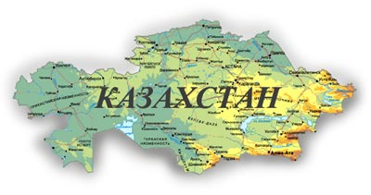
Abai Kunanbayev

Slide 2
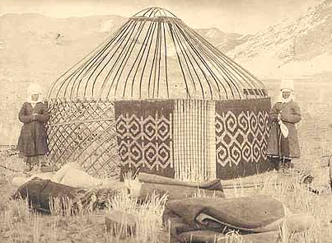
Abai (Ibrahim) Kunanbayev 1845 - 1904

Slide 3
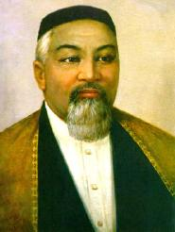
Biography
The great Kazakh poet was born in 1845 in the Chinghis Mountains in Semipalatinsk Region. His father, Kunanbai, was a stern and willful steppe ruler.
Abai`s mother, Ulzhan, was a wonderful woman. She loved her son, and called him Abai (which means thoughtful,) instead of Ibraghim – the name given the boy by his father.

Slide 4
Abai became a symbol of friendship and brotherhood between the Russian and Kazakh cultures. He loved Pushkin, Lermontov, Krylov, Saltykov – Shedrin and Tolstoi. He translated their books into Kazakh.
He loved Kazakh folk music and composed several melodies. He also wrote music for his translations from Eugene Onegin. He composed about twenty melodies.
The greatest poet Abai Kunanbaev died in 1904. The glory of Abai, the real founder of modern Kazakh culture and the greatest Kazakh classical poet, will never die.

Slide 5
The madrasah where Abai studied

Slide 6
Kazakh State University in Almaty is named after Abai , so as many streets and avenues. Statues of Abai you can see in many cities of Kazakhstan. Our school is named after Abai Kunanbayev.

Slide 7
Task I. Answer the Questions:
Abai`s mother, Ulzhan, was a wonderful woman
Ibraghim
Who was Abai?
When and where was he born?
What was his real name?
What do you know about his mother?
When did he die?
He died in 1904
He was born in 1845 in the Chinghis Mountains in Semipalatinsk Region.
A poet, a writer, a philosopher, a composer

Slide 8
Task II. Match the dates with the facts of Abai.
1845 He composed many melodies.
20 He started his poetic career from translating Krylov, Pushkin and Lermontov into Kazakh.
1904 The greatest poet Abai Kunanbaev was died when he was 59.
1886 The great Kazakh poet was born in the Chinghis Mountains.

Slide 9
Read and try to understand these lines
1. When I was young, I did not think much of learning. When I grasped the sense of life, I did not appreciate it. Now I am old, it`s too late to take to science, For me, it shines in vain.
Юным был – в ум не бралось учение, Суть узрев, – в ней не постиг знaчение. Взрослым же вгрызаться в науку, Но поздно мерцает ее свечение ...

Slide 14
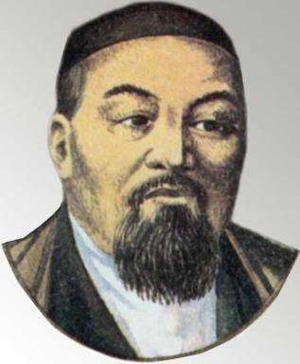
Дитя человеческое не рождается на свет разумным. Только слушая, созерцая, пробуя все на ощупь и на вкус, оно начинает познавать разницу между хорошим и плохим. Чем больше видит и слышит дитя, тем больше узнает.
Слово Девятнадцатое

