Slide 1
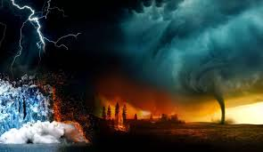
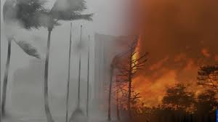
Module 1 Legend or Truth? Lesson # 3 (b) Theme “Vocabulary ”
Learning objectives:
to consolidate vocabulary from a text
to practise prepositional phrases
to practise vocabulary related extreme weather

Slide 2
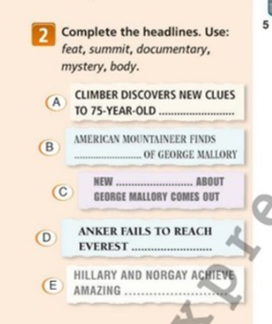
Consolidate vocabulary from a text

Slide 3
Practise prepositional phrases

Slide 4
Practise vocabulary related extreme weather

