Slide 1
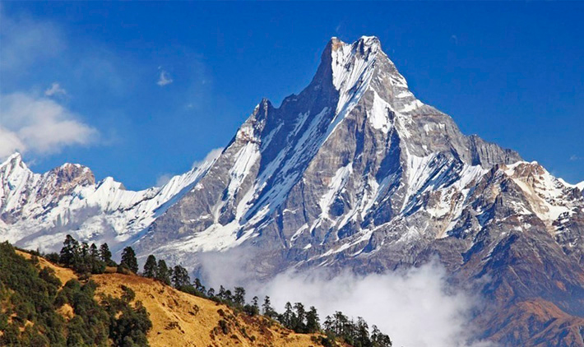
Module 1 Legend or Truth? Lesson # 2 (a) Theme “ The wildest dream. ”
Learning objectives:
to consolidate information in a text;
to consolidate new vocabulary through synonymous words;

Slide 2
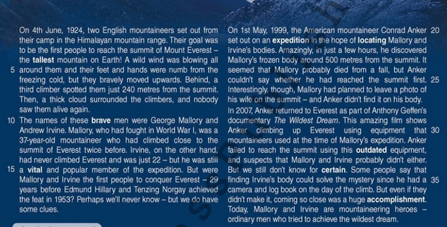
Read the text and answer the questions.

Slide 3
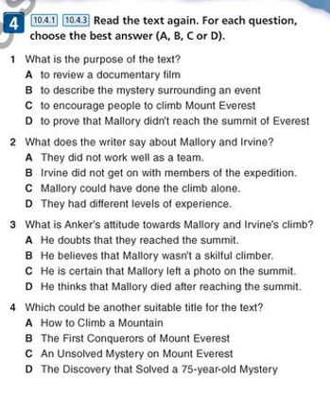

Slide 4
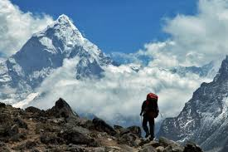
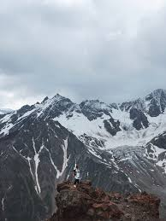
Match the words with their synonyms:
1.Important a) tallest
2.Achievement b) brave
3.courageous- c) vital
4. highest- d) expedition
5. mission- e) outdated
6. old-fashioned- f) certain
7. finding- g) accomplishment
8. sure - h) locating

Slide 5
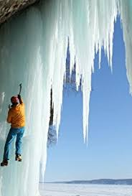
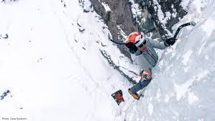
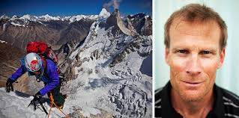
Write
Imagine you are Conrad Anker. You have just discovered Mallory’s body. Write a diary entry about the experience.

