Slide 1
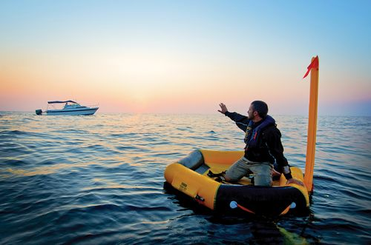
Module 1 Legend or Truth? Lesson #1 (a) Theme “Survival. ”
Learning objectives:
to read for cohesion and coherence (gap fill), to talk about survival stories, to get the overview of the module.
to Introduce and consolidate the new lexis

Slide 2
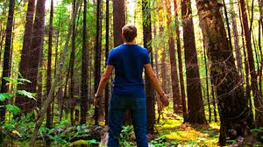
Learn the new words:
Attack
Bite off ( bit off)
Get lost
Hit
Inspire
Survive

Slide 3
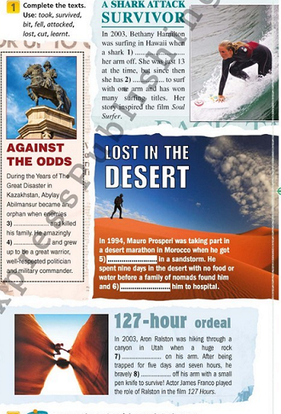
Complete the texts. Use the words :
took
survived
bit
fell
attacked
lost
cut
learnt

Slide 4
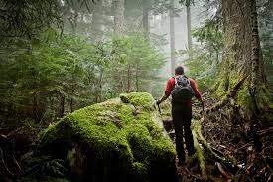
Writing
write about your or your friends’ survival in some dangerous place.
( 5 -7 sentences
minimum)

